Slide 1

Digital Image Processing
Unit-2: Image Enhancement in Spatial Domain
Dr. Piyush Joshi
Indian Institute of Information Technology
Sri City, Andhra Pradesh

Slide 2

Spatial Domain Vs. Transform Domain
Spatial domain: image plane itself, directly process the intensity values of the image plane
Transform domain: process the transform coefficients, not directly process the intensity values of the image plane

Slide 3
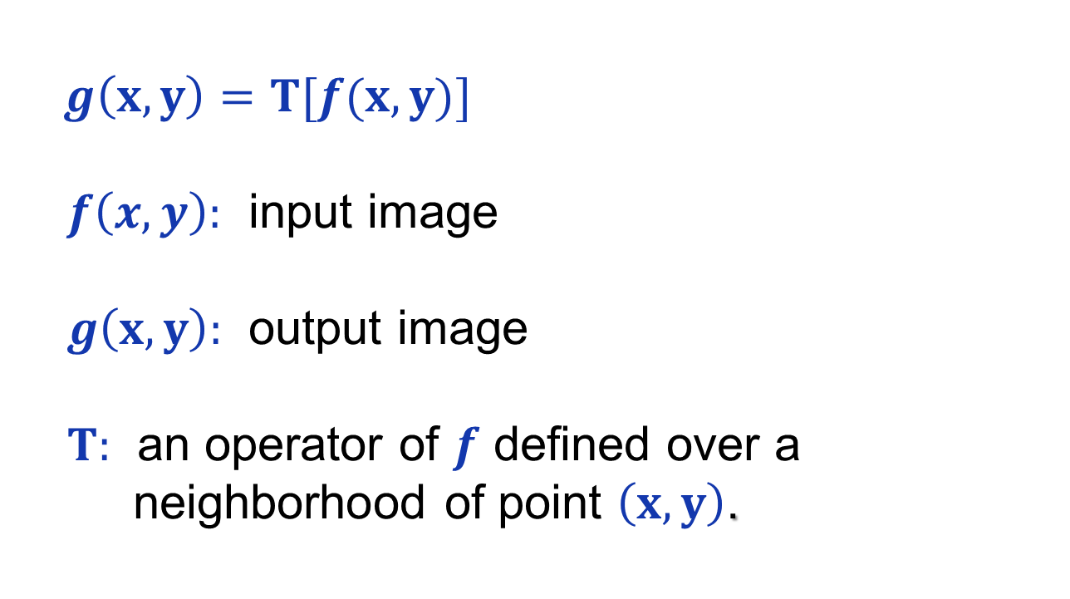
Spatial Domain Process
$g\left(x,y\right)=T[f(x,y)]$
$f\left(x,y\right):$ input image
$g\left(x,y\right):$ output image
$T:$ an operator of $f$ defined over a
neighborhood of point $\left(x,y\right)$.

Slide 4
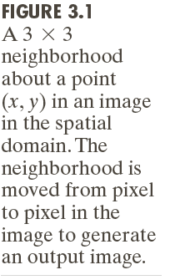

Spatial Domain Process

Slide 5
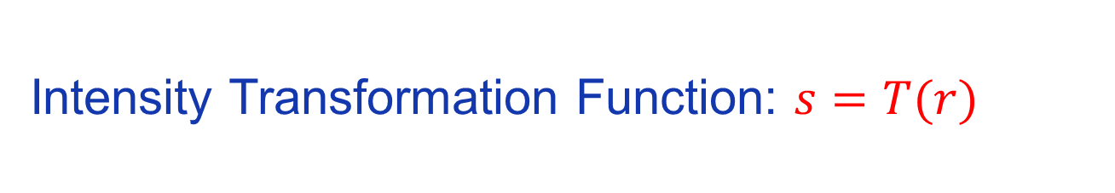
Spatial Domain Process
Intensity Transformation Function: $s=T(r)$

Slide 6
Basic Intensity Transformation Functions

Slide 7
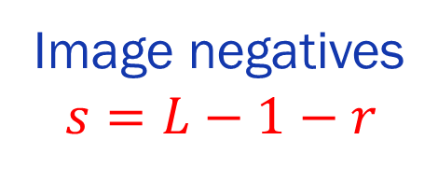
Basic Intensity Transformation Functions
Image negatives
$$s=L−1−r$$

Slide 8
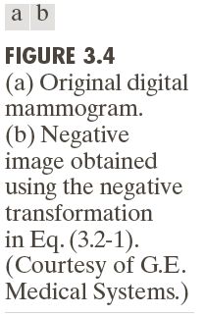
Basic Intensity Transformation Functions
Example: Image Negative
Small lesion

Slide 9
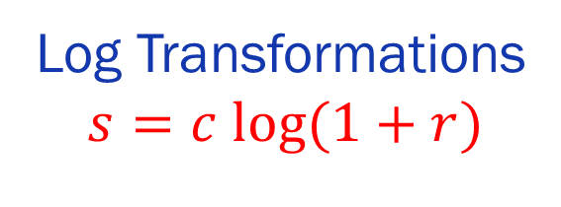
Basic Intensity Transformation Functions
Log Transformations
$$s=c log(1+r)$$

Slide 10
Basic Intensity Transformation Functions
Example: Log Transformations

Slide 11
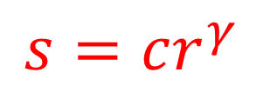
Basic Intensity Transformation Functions
Power-Law (Gamma) Transformations
$$s=cr^{γ}$$

Slide 12
Basic Intensity Transformation Functions
Example: Gamma Transformations

Slide 13
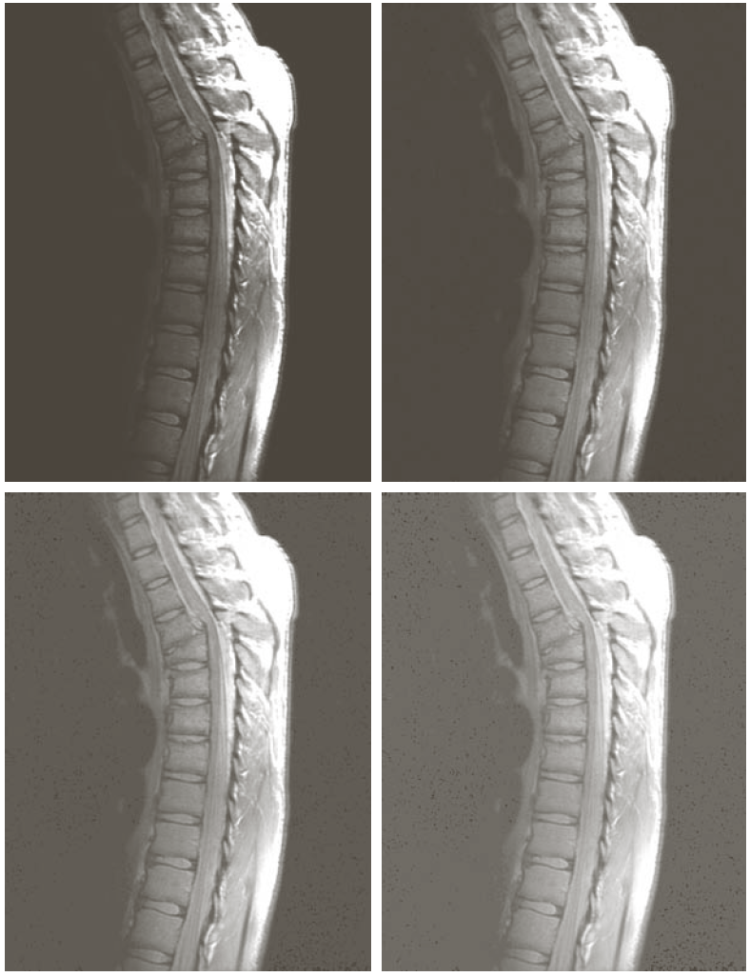
Basic Intensity Transformation Functions
More Example: Gamma Transformations

Slide 14
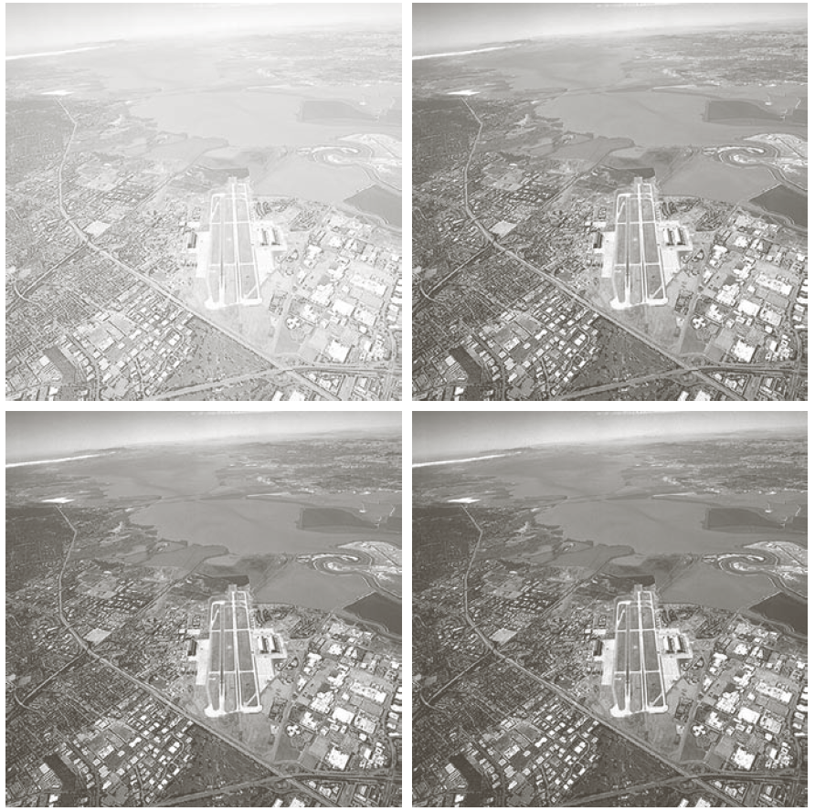
Basic Intensity Transformation Functions
More Example: Gamma Transformations

Slide 15
Piecewise-Linear Transformations
Contrast Stretching
Expands the range of intensity levels in an image so
that it spans the full intensity range of the recording
medium or display device.
Intensity-level Slicing
Highlighting a specific range of intensities in an image
often is of interest.

Slide 16
Piecewise-Linear Transformations

Slide 17
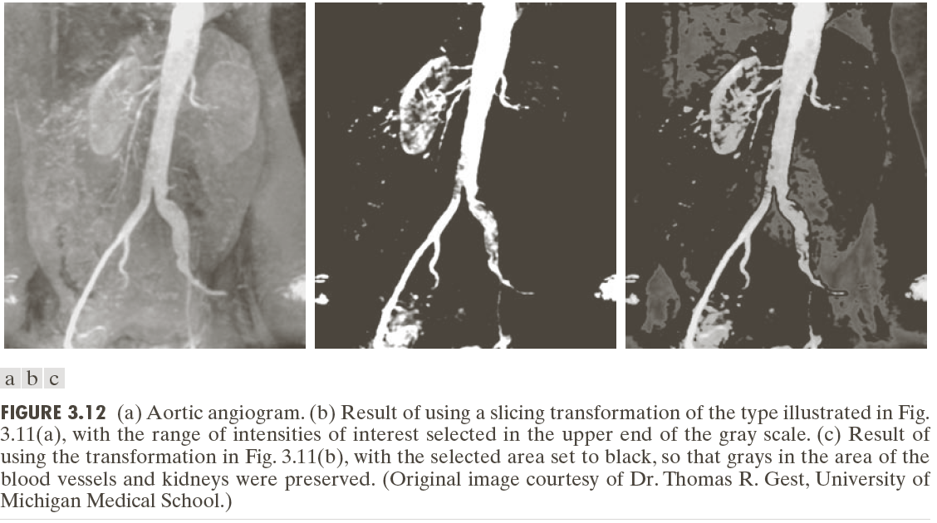

Slide 19
Image Enhancement in Spatial Domain
Histogram Processing
Histogram Equalization
Histogram Matching
Local Histogram Processing
Using Histogram Statistics for Image Enhancement

Slide 20
Image Enhancement in Spatial Domain
Histogram Processing

Slide 21
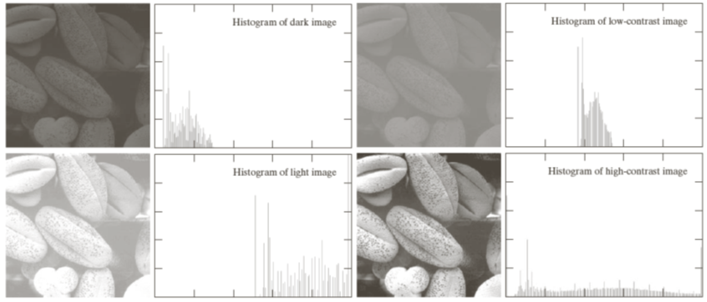
Image Enhancement in Spatial Domain
Histogram Processing

Slide 22

Image Enhancement in Spatial Domain
Histogram Equalization
$s=T\left(r\right)$

Slide 23
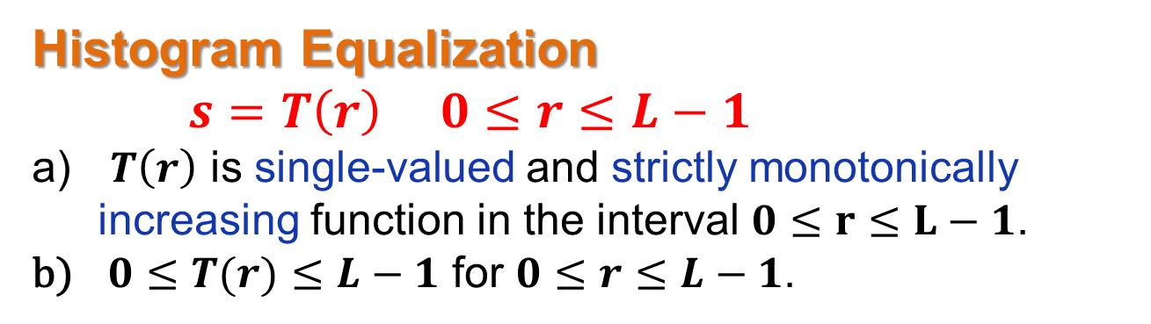
Image Enhancement in Spatial Domain
Histogram Equalization
$s=T\left(r\right) 0≤r≤L−1$
$T\left(r\right)$ is single-valued and strictly monotonically increasing function in the interval $0≤r≤L−1$.
$0≤T(r)≤L−1$ for $0≤r≤L−1$.

Slide 24
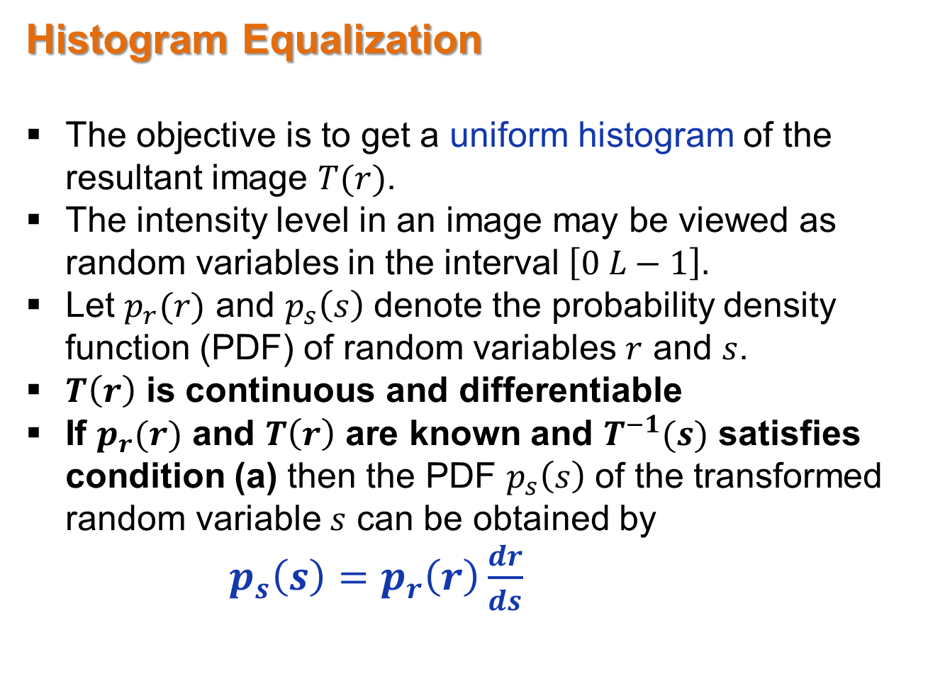
Image Enhancement in Spatial Domain
Histogram Equalization
The objective is to get a uniform histogram of the resultant image $T(r)$.
The intensity level in an image may be viewed as random variables in the interval $\left[0 L−1\right].$
Let $p_{r}(r)$ and $p_{s}\left(s\right)$ denote the probability density function (PDF) of random variables $r$ and $s$.
$T\left(r\right)$ is continuous and differentiable
If $p_{r}(r)$ and $T\left(r\right)$ are known and $T^{−1}(s)$ satisfies condition (a) then the PDF $p_{s}\left(s\right)$ of the transformed random variable $s$ can be obtained by
$p_{s}\left(s\right)=p_{r}\left(r\right)\frac{dr}{ds}$

Slide 25
Image Enhancement in Spatial Domain
Histogram Equalization
Cumulative Distribution Function
Satisfies condition (a) and (b)

Slide 26
Image Enhancement in Spatial Domain
Histogram Equalization

Slide 27
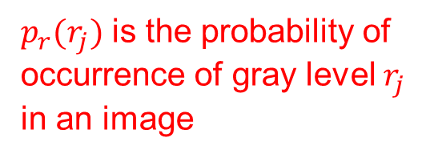
Image Enhancement in Spatial Domain
Histogram Equalization
$p_{r}(r_{j})$ is the probability of
occurrence of gray level $r_{j}$
in an image
histogram equalization

Slide 28
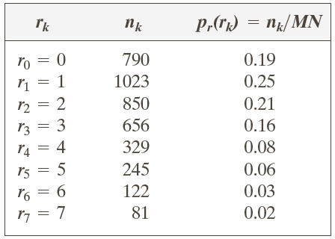
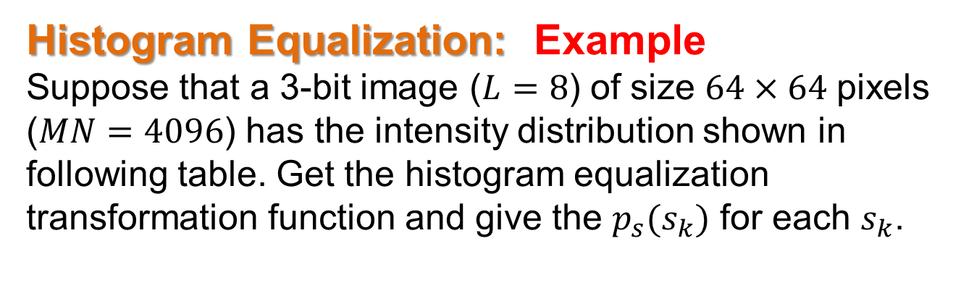
Image Enhancement in Spatial Domain
Histogram Equalization: Example
Suppose that a 3-bit image ($L=8$) of size $64×64$ pixels ($MN=4096$) has the intensity distribution shown in following table. Get the histogram equalization transformation function and give the $p_{s}(s_{k})$ for each $s_{k}$.

Slide 29
Image Enhancement in Spatial Domain
Histogram Equalization: Example

Slide 30
Image Enhancement in Spatial Domain
Histogram Equalization: Example

